Slide 1
UNIT-4

Slide 2
Topics to be covered in UNIT-4
Arrays:
Definition and declaration, Initialization, Accessing elements of arrays, Storing values in arrays,
Inter-function Communication:
Passing individual elements,
Passing the whole array,
Array Applications:
Bubble Sort,
Sequential Search,
Two Dimensional and Multidimensional Arrays.

Slide 3
Arrays in C:
Often we need many different variables that are of the same type and
play a similar role in the program.
An array is a numbered collection of variables of the same type.
An array is a homogeneous collection of data.
An array represents a group of related data.
The variables in an array share the same name and are distinguished
from one another by their numbers or subscripts.
We can loop through the variables of an array by using a variable for the
subscript.
The subscripts are always 0,1,…, size-1.

Slide 4
Array Characteristics:
An array has two distinct characteristics:
An array is ordered: Data is grouped sequentially.
An array is homogenous: Every value within the array must share the
same data type.
In other words, an int array can only hold ints, not doubles.

Slide 5
How to create an array:
Creation of an consists two things: Element Type and Array Size.
Element Type: What kind of data an array can hold?
An array can hold any one of the following data:
integer, double, character data.
Array Size: How many elements an array can contain?
Once an array size is defined it cannot be changed at run-time.
Using arrays in C:
In C, arrays can be classified based on how the data items are arranged for human understanding. Arrays are broadly classified into three categories,
1. One Dimensional Arrays
2. Two Dimensional Arrays
3. Multi Dimensional Arrays

Slide 6
One Dimensional Arrays:
One dimensional array is a linear list consisting of related and similar
data items.
In memory all the data items are stored in contiguous memory locations
one after the other.
Syntax for declaring One Dimensional Arrays:
elementType arrayName[size];
Where elementType specifies data type of each element in the array,
arrayName specifies name of the variable you are declaring and
size specifies number of elements allocated for this array.
To declare regular variables we just specify a data type and a unique
name. Example: int number;
To declare an array, we just add an array size.
Example: int temp[5]; //Creates an array of 5 integer elements.
Example: double stockprice[31];
//Creates an array of 31 double elements.

Slide 7
Initializing One Dimensional Arrays
If array is not initialized it contain garbage values.
Types of array initializations:
Option 1: Initializing all memory locations
Option 2: Initialization without size
Option 3: Partial array initialization
Option 4: Initializing an entire array with zero.

Slide 8
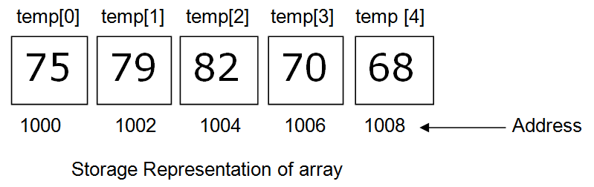
Initializing One Dimensional Arrays (Cont…)
Option 1: Initializing all memory locations:
If you know all the data at compile time, you can specify all your data
within brackets:
int temp [5] = {75, 79, 82, 70, 68};
During compilation, 5 contiguous memory locations are reserved by the
compiler for the variable temp and all these locations are initialized as
shown below.
If the size of integer is 2 bytes, 10 bytes will be allocated for the
variable temp.

Slide 9
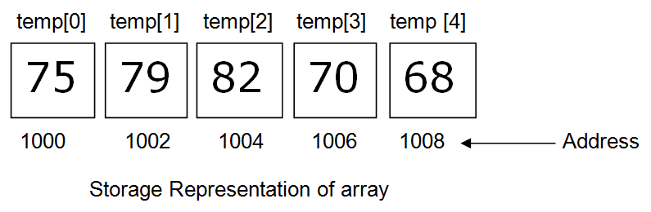
Initializing One Dimensional Arrays (Cont…)
Option 2: Initialization without size:
If you omit the size of an array, but specify an initial set of data, then the
compiler will automatically determine the size of an array.
int temp [] = {75, 79, 82, 70, 68};
In the above declaration, even though you have not specified exact
number of elements to be used in array temp, the array size will be set
with the total number of initial values specified.
Here, the compiler creates an array of 5 elements. The array temp is
initialized as shown below.

Slide 10
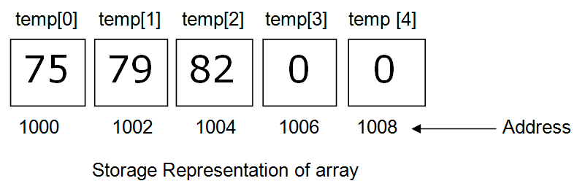
Initializing One Dimensional Arrays (Cont…)
Option 3 Partial Array Initialization:
If the number of values to be initialized is less than the size of the
array, then the elements are initialized in the order from 0th location.
The remaining locations will be initialized to zero automatically.
int temp [5] = {75, 79, 82};
Even though compiler allocates 5 memory locations, using the above
declaration statement, the compiler initializes first three locations with
75, 70 and 82, and the next set of memory locations are automatically
initialized to 0’s by the compiler as shown below.

Slide 11
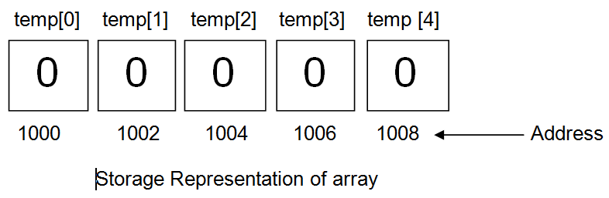
Initializing One Dimensional Arrays (Cont…)
Option 4: Initializing an entire array with zero:
If you do not know any data ahead of time, but you want to initialize
everything to 0, just use 0 within { }. For example:
int temp [5] = {0};
This will initialize every element within the array to 0 as shown below.

Slide 12
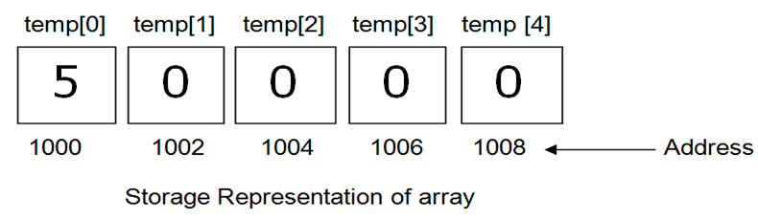
Initializing One Dimensional Arrays (Cont…)
Example:
int temp [5] = {5};
The first value is supplied in the first element memory location,
remaining all elements are placed with zero.

Slide 13
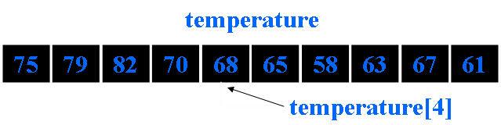
Accessing elements of one dimensional array:
You know how to declare and initialize an array. Now lets understand,
how to access an array elements.
To access an array element use name of the array with the subscript in
brackets.
Suppose you have an array called temperature, for storing temperature
in a year.
Then the subscripts would be 0,1,…,364.
For example to access temperature of fifth day:
temperature [4]

Slide 14
Accessing elements of one dimensional array(Cont…)
To assign or store the value 89 for the 150th day:
temperature [149] = 89;
You can loop through the elements of an array by varying the subscript.
To set all of the values to 0, say
for(i = 0;i < 365; i++)
temperature[i] = 0;
You can not use assignment statement directly with arrays.
If a[] , b[] are two arrays then the assignment a=b is not valid.
C does not provide array bounds checking.
Hence, if you have
double stockPrice[5];
printf ("%d", stockPrice[10]);
This will compile, but you have overstepped the bounds of your array.
You may therefore get wrong value.

Slide 15
Accessing elements of one dimensional array(Cont…)
//Example for accessing array elements.
#include<stdio.h>
main() {
int arr[10];
int i = 0;
for(i=0;i<sizeof(arr);i++) {
arr[i] = i; // Initializing each element separately
}
int j = arr[5]; // Accessing the 5th element of integer array arr //and assigning its value to integer 'j'.
printf(“Value at 5th location is: %d”,j);
}
As we can see above, the 5th element of an array is accessed as ‘arr[5]‘.
Note that for an array declared as int arr[5].
The five values are represented as: arr[0] arr[1] arr[2] arr[3] arr[4]
and not arr[1] arr[2] arr[3] arr[4] arr[5]
The first element of array always has a subscript of ’0′.

Slide 16
//Program to calculate sum of all the array elements.
#include <stdio.h>
void main()
{
int a[10];
int i, size, total=0;
printf("\n Enter the size of the array : ");
scanf("%d", &size);
printf("\n Enter the elements of an array : ");
for (i = 0; i < size ; i++)
scanf("%d",&a[i]);
for (i = 0; i < size ; i++)
total += a[i];
printf(“Sum of all array elements: %d", total);
}

Slide 17
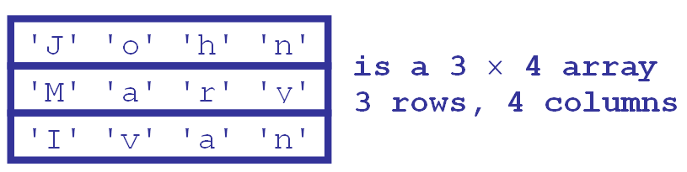
Two Dimensional Arrays:
Two-dimensional array are those type of array, which has finite number
of rows and finite number of columns.
An array of array is called a two-dimensional array and can be
represented as a table with rows and columns.
This is an array of size 3 names whose elements are arrays of size 4.

Slide 18
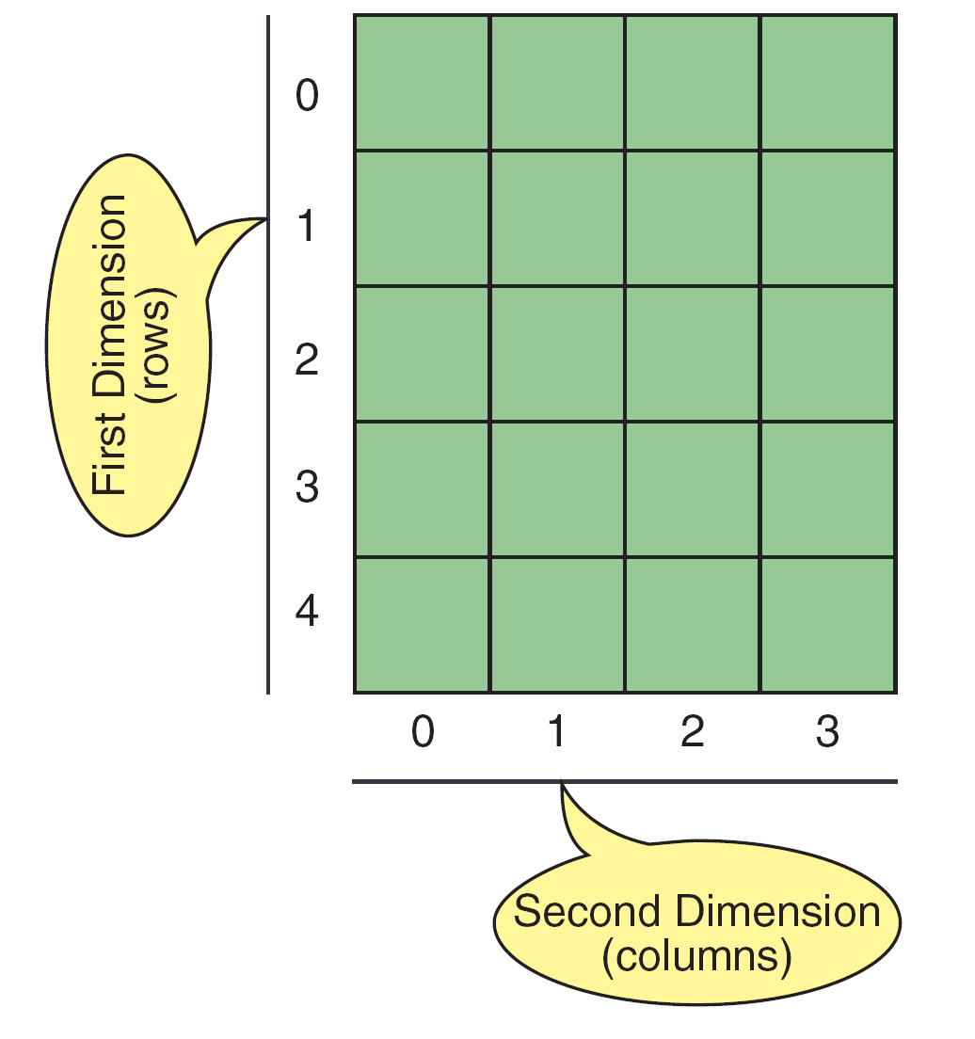
Declaration of Two Dimensional Arrays:
Syntax: elementType arrayName [row_size][column_size];
Two-dimensional Array representation

Slide 19
Two Dimensional Arrays(Cont…)
The declaration form of 2-dimensional array is
elementType arrayName [row_size][column_size];
The elementType may be any valid type supported by C.
The rule for giving the arrayName is same as the ordinary variable.
The row_size and column_size should be an individual constant.
The following declares a two-dimensional 3 by 3 array of integers and
sets the first and last elements to be 10.
int matrix [3][3];
matrix[0][0] = 10;
matrix[2][2] = 10;
In the declaration of two dimensional array the column size should be
specified, so that it can arrange the elements in the form of rows and
columns.
Two-dimensional arrays in C are stored in "row-major format": the
array is laid out contiguously, one row at a time.
 | [0] | [1] | [2]
[0] | 10
[1]
[2] |  |  | 10

Slide 20
Initialization of Two Dimensional Arrays:
An array may be initialized at the time of declaration as follows:
char names [3][4] = {
{‘J’, 'o', 'h', 'n'},
{‘M’, 'a', 'r', 'y'},
{‘I’, 'v', 'a', 'n'}
};
An integer array may be initialized to all zeros as follows
int nums [3][4] = {0};
An integer array may be initialized to different values as follows
int nums [3][4] = {
{1,2,3,4},
{5,6,7,8},
{9,0,10,11}
};
To access an element of a 2D array, you need to specify both the row
and the column:
printf ("%d", nums[1][2]);

Slide 21
Initialization of Two Dimensional Arrays(Cont…)
Example:
int c[2][3] = {
{1,3,0},
{-1,5,9}
};
OR
int c[][3] = {
{1,3,0},
{-1,5,9}
};
OR
int c[2][3] = {1,3,0,-1,5,9};

Slide 22
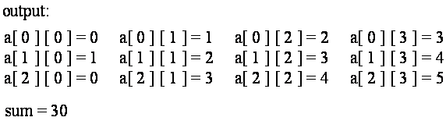
//Program to print sum of elements of a matrix.
#define M 3 /* Number of rows */
#define N 4 /* Number of columns */
main() {
, int a [ M ] [ N ], i, j, sum = 0;
for ( i = 0; i < M; ++i ) {
for (j = 0; j < N, ++j ){
scanf (%d”, &a [i] [j]);
}
}
for ( i = 0; i < M; ++i ) {
for (j = 0; j < N, ++j ) {
printf(“a [ %d ] [ %d ] = %d “, i, j, a[ i ] [ j ]);
}
printf (“\n”);
    }
  for ( i = 0; i < M; ++i ) {
    for (j = 0; j < N, ++j ) {
sum += a[ i ] [ j ];
}
printf(“\nsum = %d\n\n”);
}
}

Slide 23
Multi Dimensional Arrays:
C allows three or more dimensions. The exact limit is determined by the
compile.
The general form of multidimensional array is
elementType arrayName [s1][s2][s3]…[sm];
Where si is the size of the i^{th} dimension.
Array declarations read right-to-left
For Example: int a[3][5][4];
It is represented as “an array of ten arrays of three arrays of two ints”
In memory the elements are stored as shown in below figure.

Slide 24
Example:
int table[3][5][4] = {
{
{000,001,002,003},
{010,011,012,013},
{020,021,022,023},
{030,031,032,033},
{040,041,032,043}
},
{
{100,101,102,103},
{110,111,112,113},
{120,121,122,123},
{130,131,132,133}, {140,141,142,143}
},
{
{200,201,202,203},
{210,211,212,213},
{220,221,222,223},
{230,231,232,233}, {240,241,242,243}
}
};

Slide 25
Inter-function communication (Functions with Arrays):
Like the values of variable, it is also possible to pass values of an array
to a function.
There are two types of passing an array to the function:
  1. Passing Individual Elements
  2. Passing the whole array
1. Passing Individual Elements:
int a;
fun(a);
int a[10];
fun(a[3]);
void fun(int x)
{
-------
-------
}

Slide 26
Inter-function communication (Functions with Arrays) Cont…
2. Passing the whole array:
To pass an array to a called function, it is sufficient to list the name of
the array, without any subscripts, and the size of the array as arguments.
For example, the function call findMax(a, n); will pass all the elements
contained in the array a of size n.
The called function expecting this must be appropriately defined.
The findMax function header looks like: int findMax(int x[], int size)
The pair of brackets informs the compiler that the argument x is an array
of numbers. It is not necessary to specify the size of the array here.
The function prototype takes of the form
int findMax (int [], int );
int findMax (int a [], int );

Slide 27

//Program to read an array of elements and find max value.
#include<stdio.h>
int findMax(int[],int);
void main()
{
int a[10], n ,i , max;
printf(“\n Enter the size of the array “);
scanf(“%d”,&n);
printf(‘\n Enter the elements of the array : “);
for(i=0;i<n;i++)
scanf(“%d”,&a[i]);
max=findMax(a, n);
printf(“\n The Maximum value =%d”, max);
}
int findMax(int x[],int size)
{
int temp;
temp=x[0];
for(i=1;i<size; i++)
{
if(x[i]>temp)
{
temp=x[i];
}
}
return temp;
}

Slide 28
Linear Search (Sequential Search ):
A linear or sequential search of an array begins at the beginning of the array
and continues until the item is found or the entire array has been searched.
  It is the basic searching technique.
  Very easy to implement
  The array DOESN’T have to be sorted.
  All array elements must be visited if the search fails.
  Could be very slow.

Slide 29
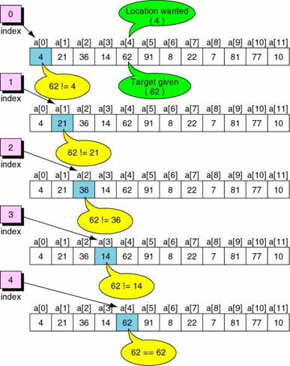
Example: Successful Linear Search

Slide 30
//Program to find a number in the array using sequential search.
main() {
int a[10],i,n,m,c=0;
printf("Enter the size of an array: ");
scanf("%d",&n);
printf("Enter the elements of the array: ");
for(i=0;i<=n-1;i++){
scanf("%d",&a[i]);
}
printf("Enter the number to be search: ");
    scanf("%d",&m);
    for(i=0;i<=n-1;i++) {
if(a[i]==m) {
c=1;
break;
}
}
if(c==0)
printf("The number is not in the list");
else
printf("The number is found");
}
Output:
Enter the size of an array: 5
Enter the elements of the array: 4 6 8 0 3
Enter the number to be search: 0
The number is found

Slide 31
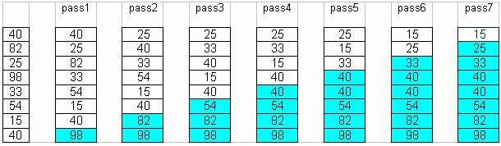
Bubble Sort Algorithm
The idea of Bubble (or exchange) sort is to scan through the list and swap each
pair of adjacent elements that are in the wrong order.
The process is repeated each time from index zero to one less than the previous
limit until either the list is exhausted or until a pass that involve no swap is
encountered.
At the end of first pass, the largest element will move (or bubble up) to the end
of the list.
At the end of the second swap, the second largest will move to its right place,
etc.
The following table shows a trace of how bubble sort works.

Slide 32
Bubble sort
Suppose the following numbers are stored in an array: 32,51,27,85,66,23,13,57
Pass-1
32 51 27 85 66 23 13 57 no swap
32 27 51 85 66 23 13 57
32 27 51 85 66 23 13 57 no swap
32 27 51 66 85 23 13 57
32 27 51 66 23 85 13 57
32 27 51 66 23 13 85 57
32 27 51 66 23 13 57 85
Pass-2
27 32 51 66 23 13 57 85
27 32 51 66 23 13 57 85 no swap
27 32 51 66 23 13 57 85 no swap
27 32 51 23 66 13 57 85
27 32 51 23 13 66 57 85
27 32 51 23 13 57 66 85
and so on…

Slide 33
//C program to sort the numbers using bubble sort
main() {
int arr[50],temp,i,j,n;
printf("\nEnter any Value less Than 50:");
scanf("%d",&n);
printf("\n\tEnter The Values into ARRAY: ");
for(i=0;i<n;i++)
scanf("%d",&arr[i]);
for(i=1;i<n;i++) {
for(j=0;j<n-i;j++) {
if(arr[j] >arr[j+1]) {
temp=arr[j];
arr[j]=arr[j+1];
arr[j+1]=temp;
}
}
}
printf(“\nSorted Series:");
for(i=0;i<n;i++) {
printf("\n %d",arr[i]);
}
}
Output:
Enter any Value less Than 50: 5
Enter The Values into ARRAY: 1 5 0 3 2
Sorted Series: 0 1 2 3 5

Slide 34
Note:
The same concept is applied for passing a multidimensional array to a
function.
Here you need to specify the column size.
For example to read two-dimensional array elements using functions, it
takes of the form:
int readElements (int [] [5], int ,int );

Slide 35
Character Arrays and Strings:
String is a sequence of characters.
If ‘\0’ is present after a series of characters in an array, then that array
becomes a string otherwise it is a character array.
Example:
char arr[] = {'a', 'b', 'c'}; //This is an array
char arr[] = {'a', 'b', 'c', '\0'}; //This is a string

